Slide 1
MARLEY INTERNATIONAL STORE DATA ANALYSIS PRESENTATION
Presenter: Kevin Ndungu – BI Developer | Data Analyst

Slide 2
AGENDA
The purpose of this presentation is to provide a comprehensive analysis of Marley International Store's data. Throughout the analysis, I've focused on highlighting key business drivers and actionable insights to guide the company's decisions.
In the analysis, I've harnessed the power of both Excel and Power BI to uncover insightful trends and recommendations. Excel served as the foundation for data preparation, cleansing, and initial exploratory analysis.
As I transitioned to the presentation phase, Power BI became the canvas for visual storytelling. Its robust visualization capabilities enables me to present complex data patterns with clarity and impact.
I'll cover a range of topics, including the total revenue by month, product category contributions, sales trends, region profitability, average profit margin, and more. Each of these insights is designed to guide the company's decision-making and strategy.

Slide 3
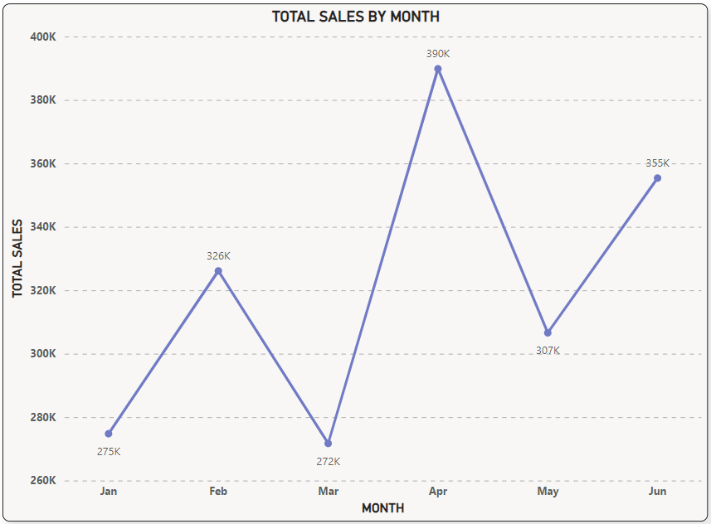
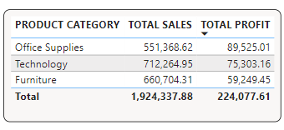
PRODUCT METRICS, VISUALIZATIONS AND ANALYSIS
Visual on the left represents total revenue by month in the first half of fiscal year 2015 amounting to USD 1,924,337.88.
March registered the highest revenue generation while a significant drop was experienced in the month of April towards May (Drop in sales for Home Office Customer Segment).
Below is a table visual for most profitable products by category.

Slide 4
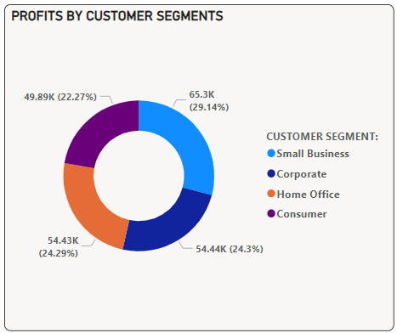
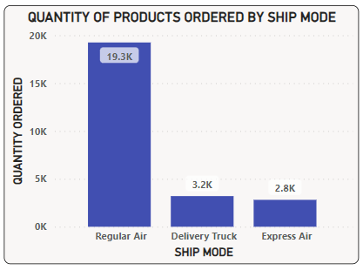
CUSTOMER SEGMENT AND SHIPMENT ANALYSIS
The visual on the left shows that the Small Business Customer segment leads in Profits followed by the rest.
Below is a visual of preferred mode of product shipment by quantity.

Slide 5
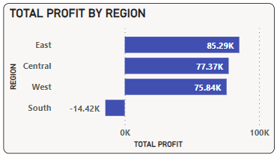
REGIONAL PROFIT ANALYSIS AND CALL FOR ACTION
The visual on the left shows profits generated by region totaling up to USD 224,077.61.
The negative profit of USD 14.42K in the South region raises concerns about potential challenges impacting profitability. Analyzing supply chain inefficiencies and competitive pressures can help transform the region's performance into a profitable contributor. Targeted efforts include optimizing operations, streamlining costs, and exploring strategies to revitalize profitability.
END.(Thanks for listening)

